Slide 1
Revisiting Target Atmospheres for Space-based DWL Concept Comparisons
G. D. Emmitt and S. A. Wood
Simpson Weather Associates
October 16 – 18, 2012
WG meeting in Boulder, CO

Slide 2
Outline
Background on Target Atmospheres
Comparison with ESA’s data base
Comparison with FASCODE/MODTRAN
Wavelength scaling
Role in OSSEs
Areas for enhancement
  Depolarization
  Solar background
  Multiple air-mass classifications

Slide 3
Background on Target Atmospheres
Developed in 1997 for use in trade studies and comparisons of DWLs operating at differing wavelengths.
Co-authored by Emmitt, Spinhirne, Menzies, Winker and Bowdle
Published on www.swa.com
Underwent several revisions as new data with 2 um, 1.06 um and .532 um observations became available.

Slide 4
TARGET ATMOSPHERES
for use in
DWL CONCEPT STUDIES
Submitted to the
New Millennium Program
by
An Ad Hoc Committee:
G.D. Emmitt, Lead
Simpson Weather Associates, Charlottesville, VA
J. Spinhirne
NASA/GSFC, Greenbelt, MD
R. Menzies
NASA/JPL, Pasadena, CA
D. Winker
NASA/LaRC, Hampton, VA
D. Bowdle
NASA/GHCC, Huntsville, AL
March 28, 1997 (1st draft)
May 2, 1997 (2nd draft)
July 23, 1997 (3rd draft)
February 2, 1998 (4th draft with edits by gde)
August 10, 2001(Edits by gde)
The following material was put together in its original form at the request of the participants of the March 1997 NMP Lidar Workshop held in Washington, D.C. Subsequently, revisions have been made, in part, in response to request for more complete representation of the attenuation coefficients.

Slide 5
Current Target Atmospheres
The basic backscatter profiles from surface to 25 km were scaled from .532 GLOBE observations. Molecular backscatter, total scatter, attenuation were derived using FASCODE.
Angstrom exponents used: λ ^{-2.5} above 3 km and λ ^{-1.5} at and below 3 km.
Added some cloud and wind turbulence for use in instrument trade studies.

Slide 6
DESIGN ATMOSPHERES
for use in
GTWS CONCEPT STUDIES**
provided by the
Science Definition Team
for the NASA/NOAA
Global Tropospheric Wind Sounder
September 22, 2001
Purpose
Having a common scattering target with internally consistent backscatter wavelength dependence enables meaningful "equal resource/equal target“ comparisons of GTWS concepts that employ Doppler lidars. While the Science Definition Team (SDT) realizes that aerosol backscatter from the atmosphere will vary over several orders of magnitude, will vary over altitude, latitude and season and will also vary over space/time scales that are not readily modeled, the GLOBE , SABLE/GABLE backscatter surveys, and the AFGL MODTRAN aerosol data bases provide a nearly consistent picture of backscatter climatology.

Slide 7
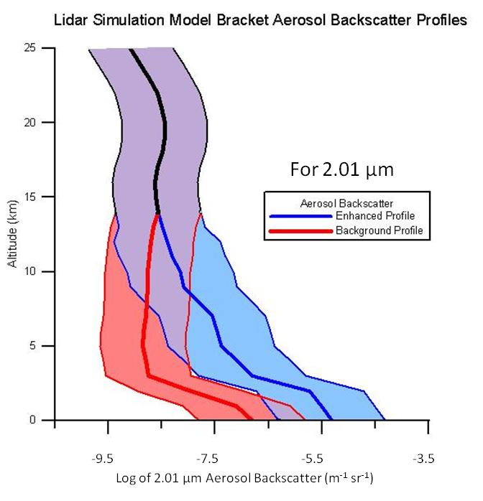

Slide 8
Comparison with ESA’s Data Base
Establishment of a backscatter coefficient
and atmospheric database
Work performed with funding from ESA to DERA
J. M. Vaughan, N. J. Geddes, Pierre H. Flamant and C. Flesia
June 1998

Slide 9
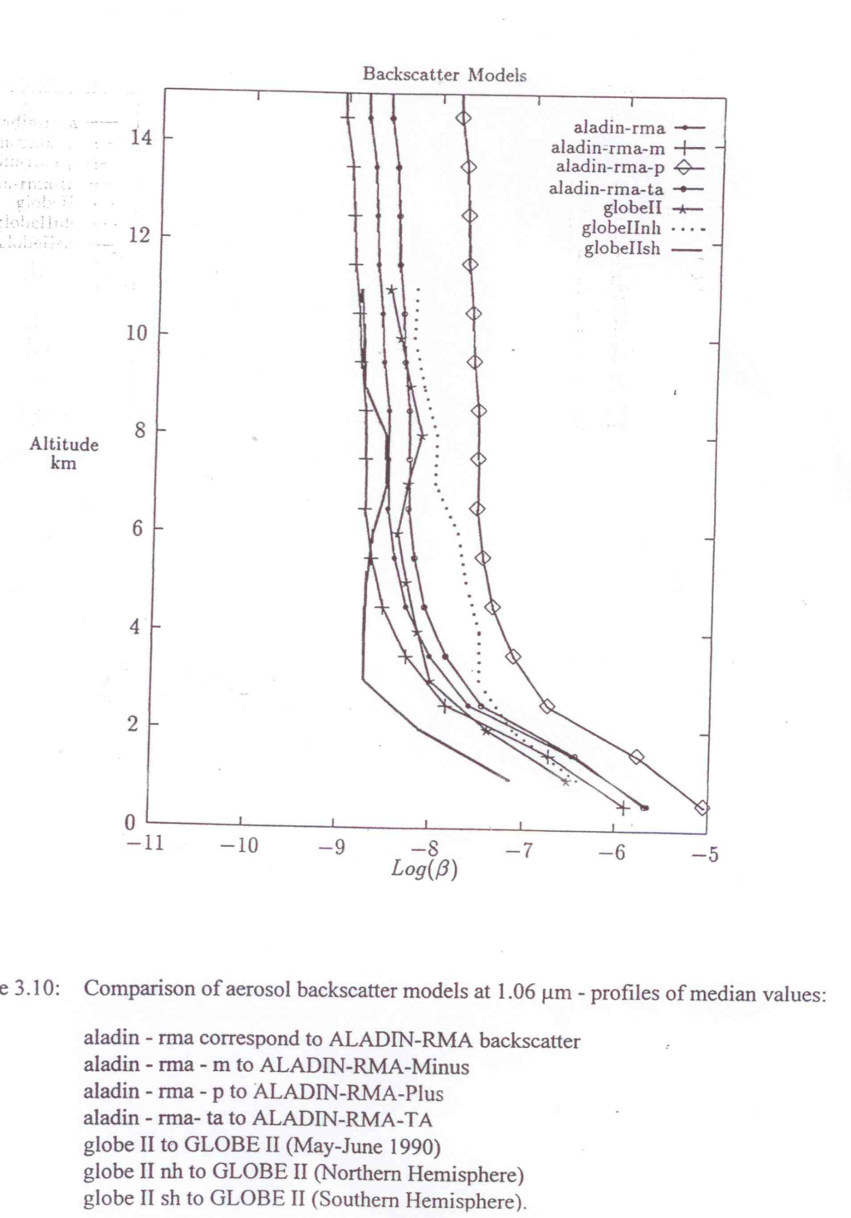

Slide 10
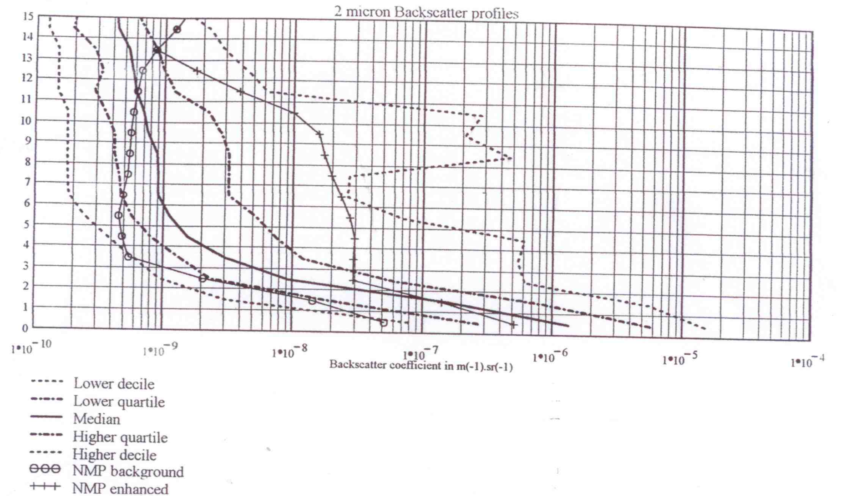

Slide 11
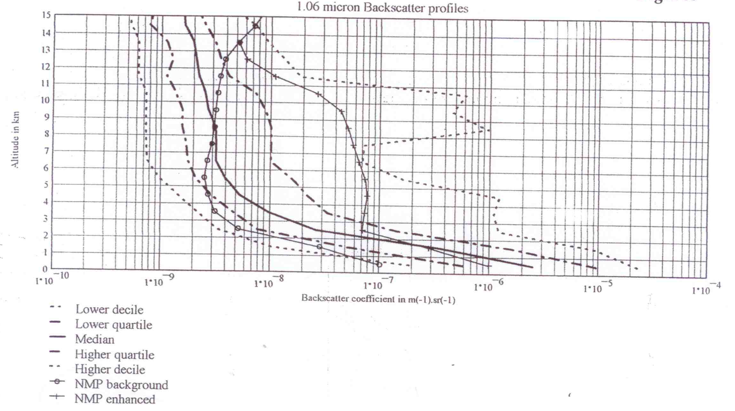

Slide 12
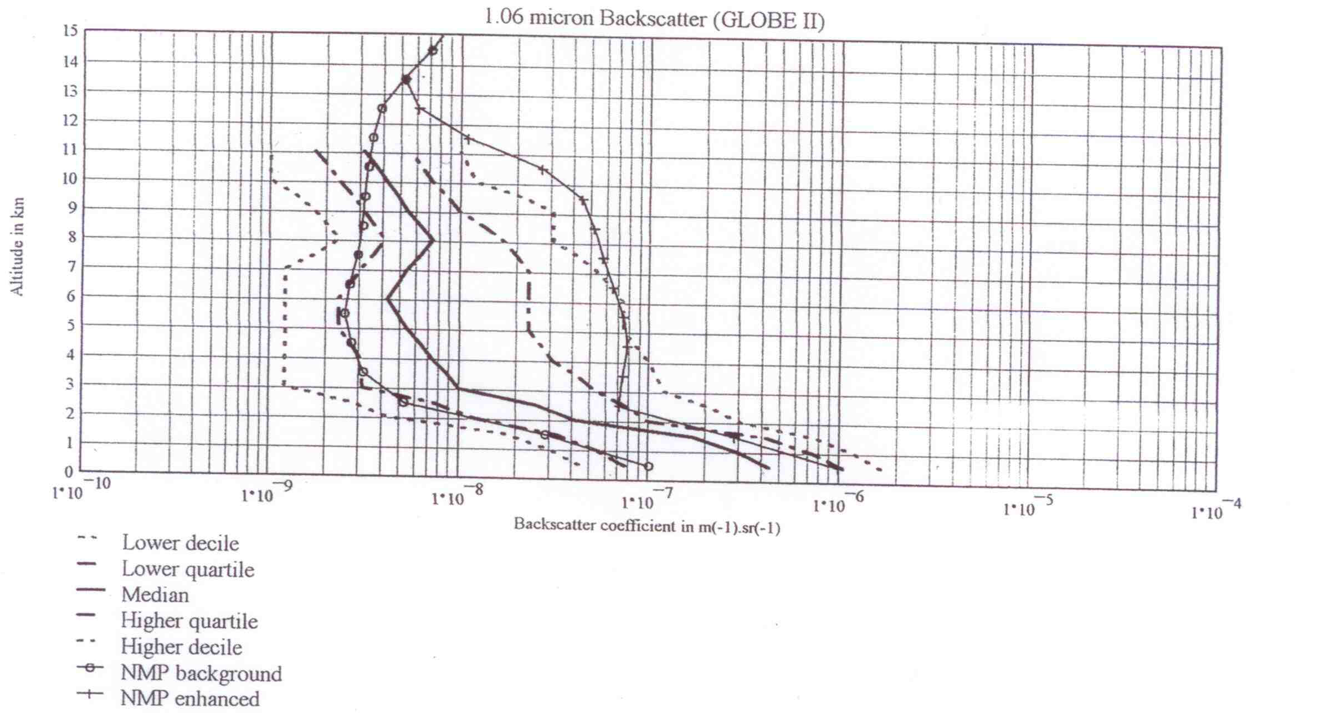

Slide 13
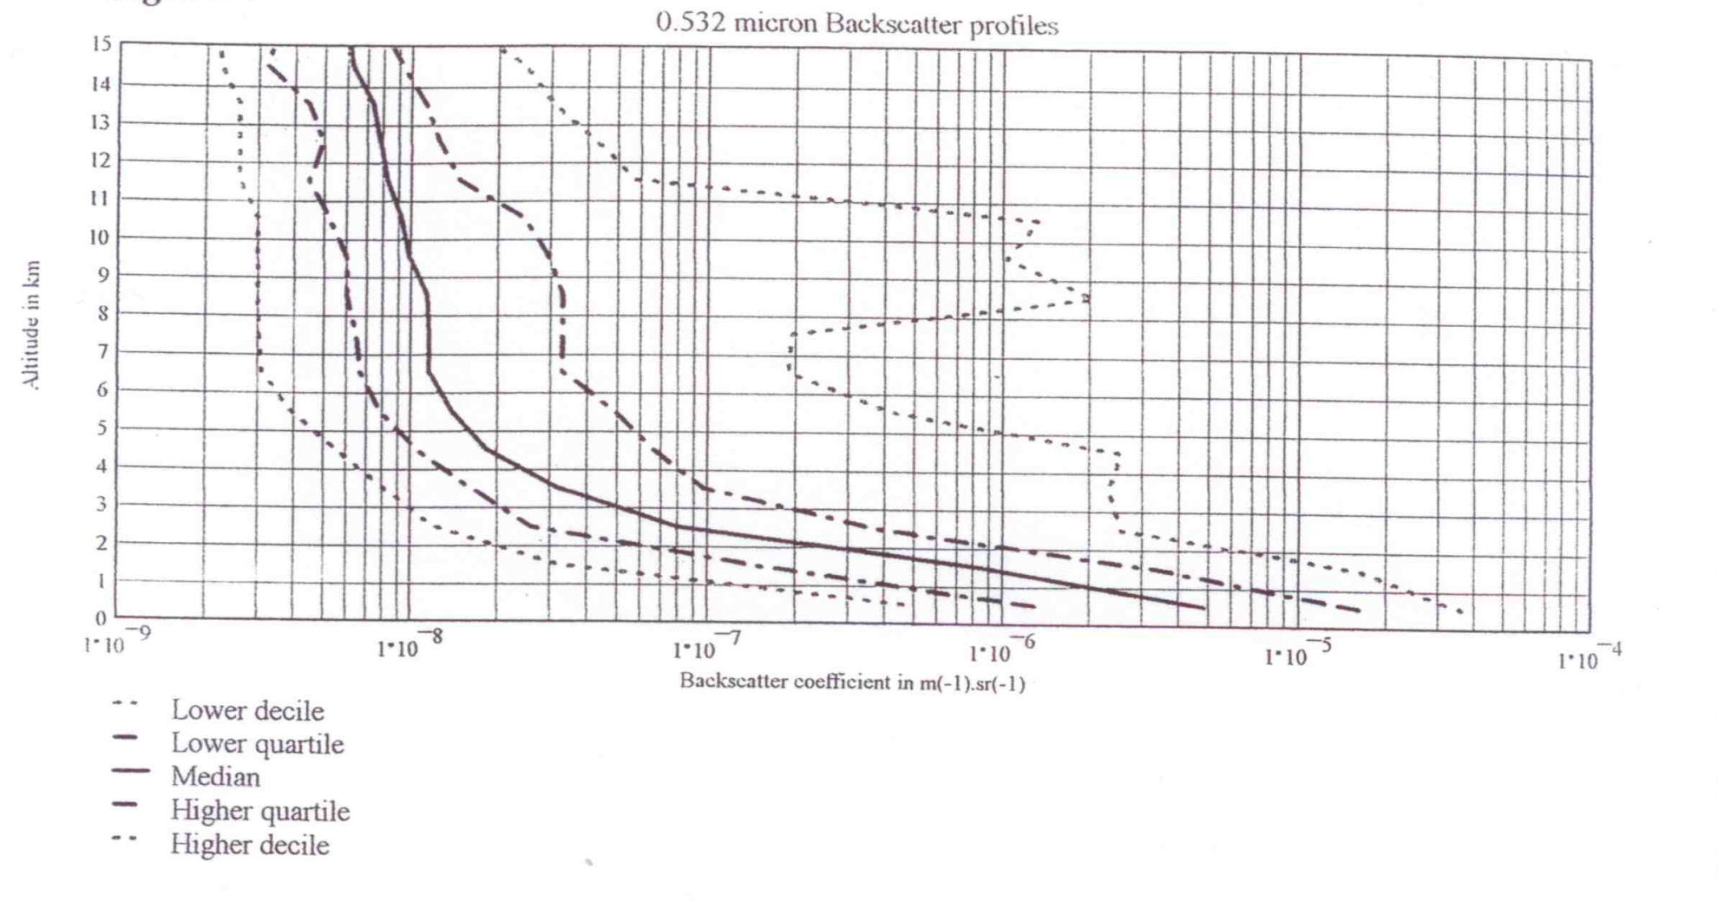

Slide 14
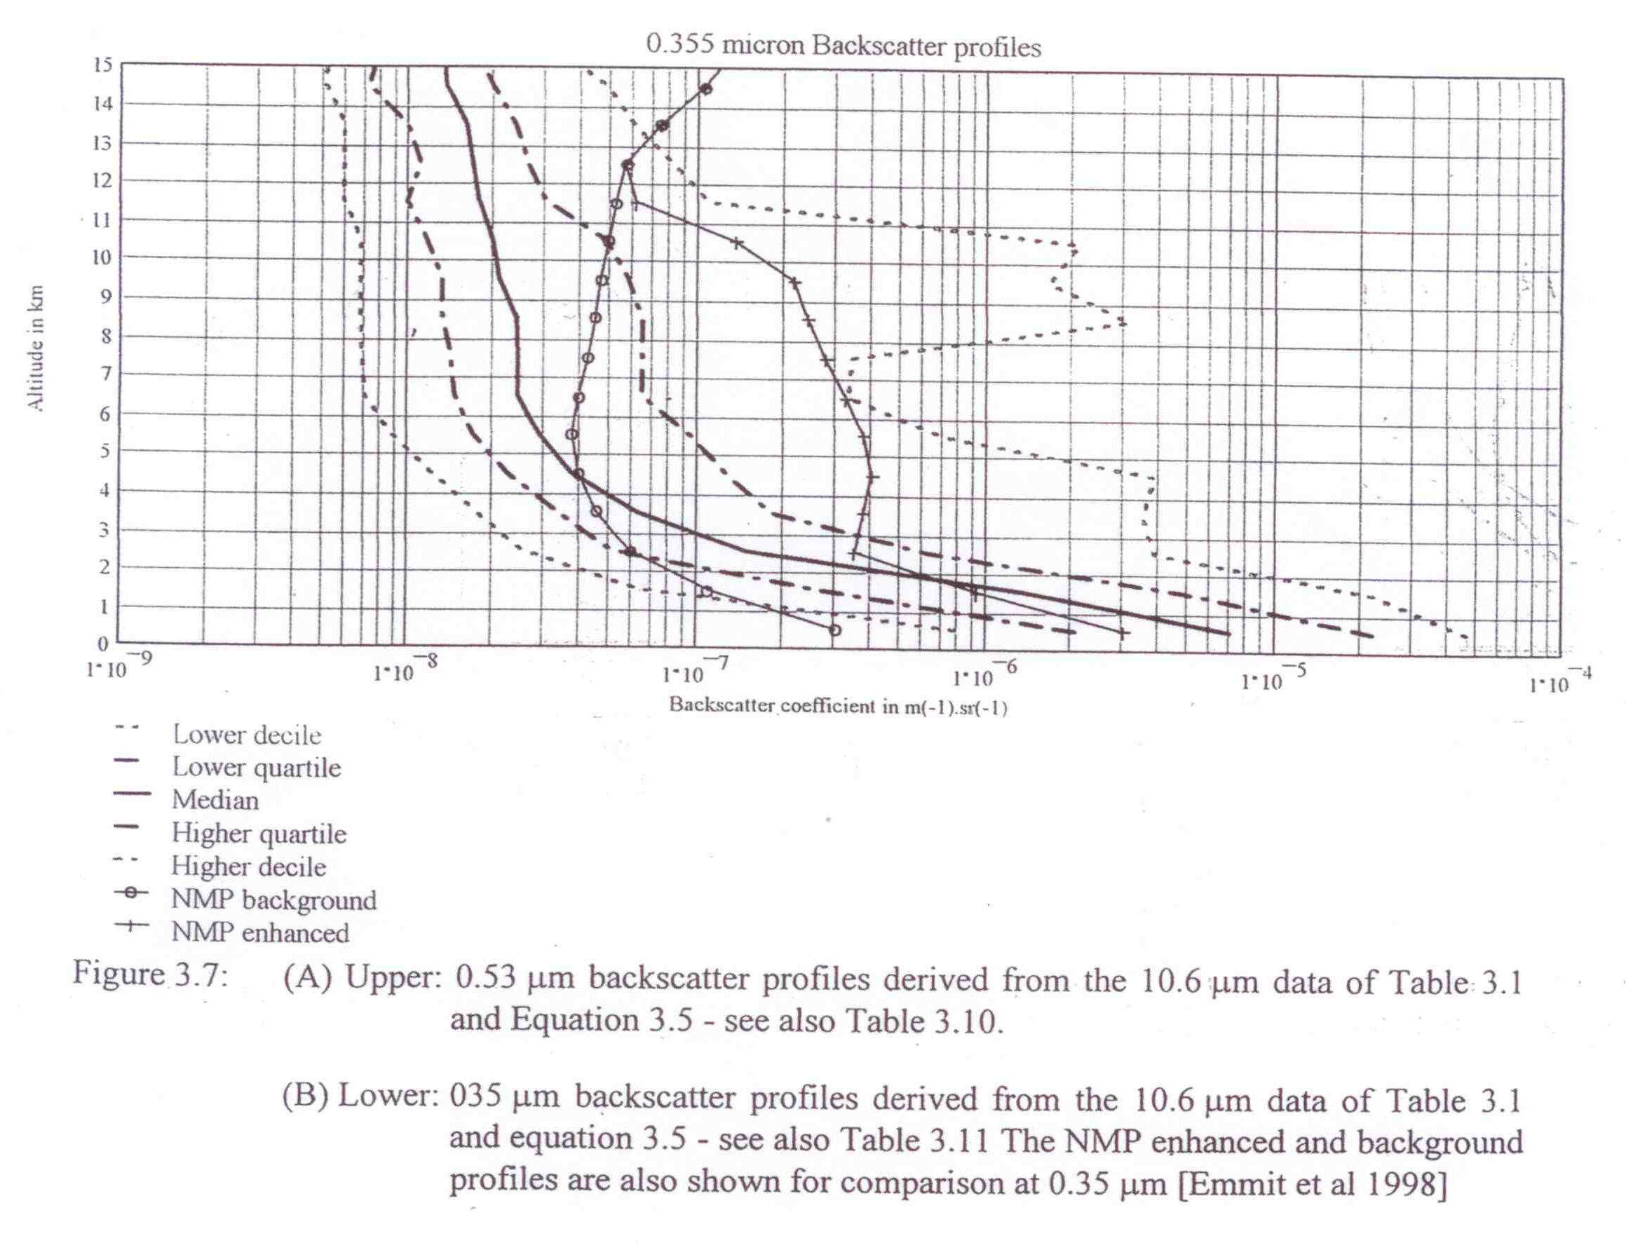

Slide 15
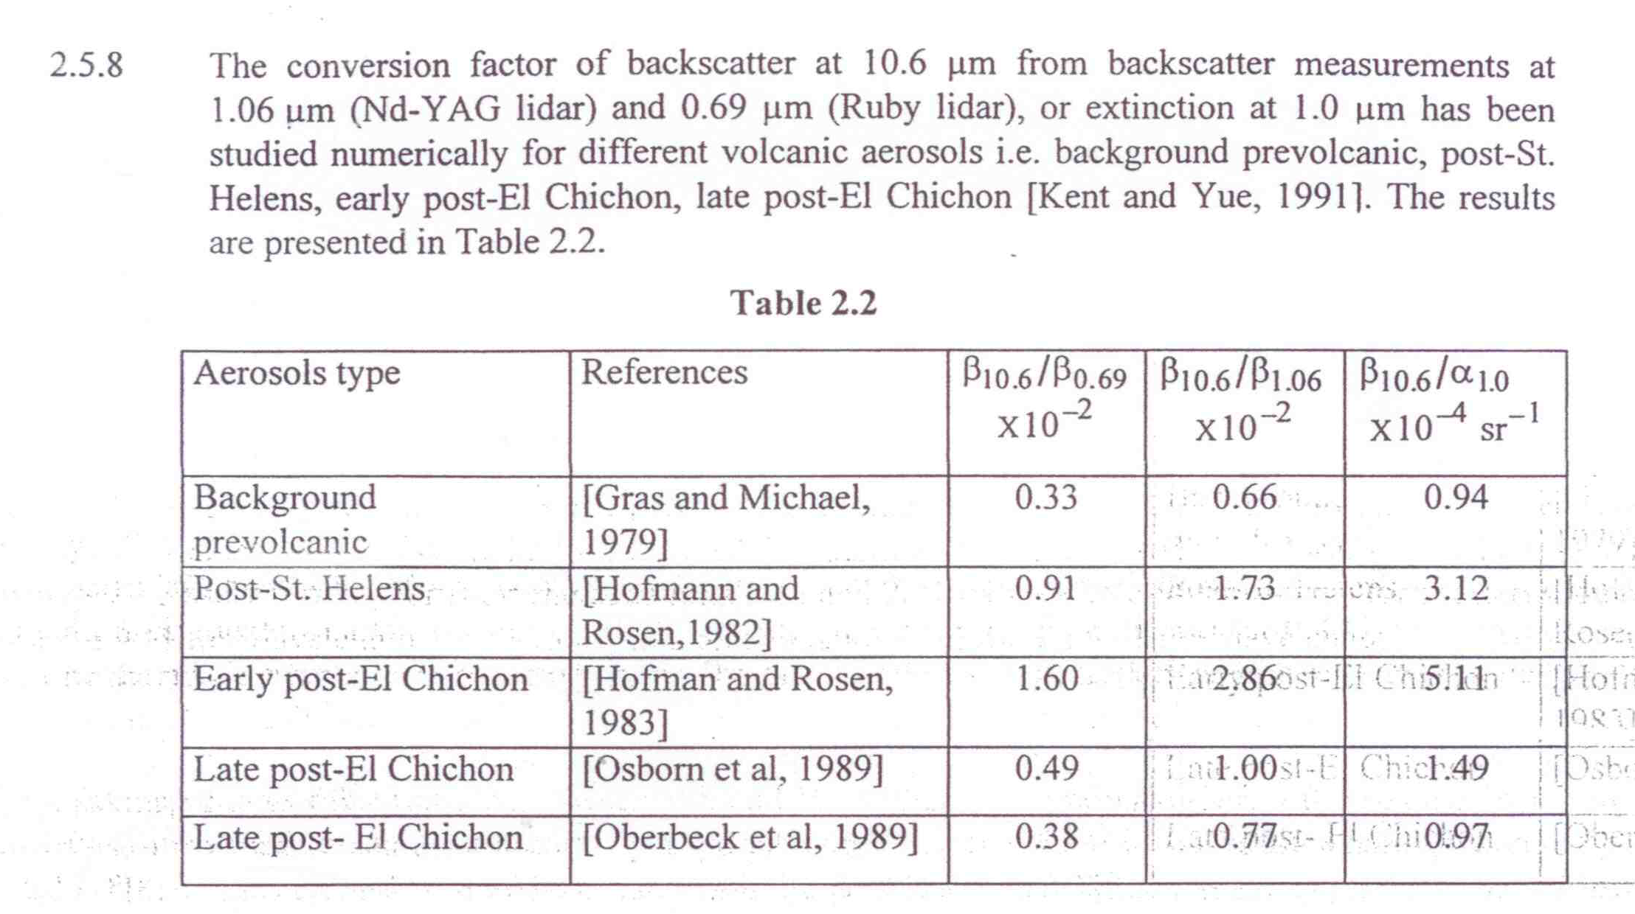

Slide 16
Comparison with FASCODE
Many engineers use MODTRAN/FASCODE in assessing performance of DWL concepts.
With a focus on the aerosol returns from the lower troposphere, we find that FASCODE/MODTRAN provides backscatter values ~ 10 – 30 times higher than those in our Target Atmospheres’ “background mode”.
Comparisons at 1 km and .355um
 | NMP(back) | NMP(enh) | MODTRAN (Maritime 23km) | ESA
Beta (a) | 1.5E-7 | 1.5E-6 | 5.5E-6 | 1.5E-6

Slide 17
Scaling Issues
Scaling expressed using an Angstrom Exponent or a Color Ratio.
Much of ESA’s backscatter database derived from 10.6 um observations in SABLE and GABLE in the Atlantic in 1988-1990 using a simple expression for the Angstrom Exponent.
NMP’s Target Atmospheres derived from 1.06 um and .532um observations made in GLOBE 1990 over the Pacific using two differing Angstrom Exponents.
The following few slides are based upon modeling done with NASA/ROSES funding for the analyses of CALIPSO data. Modeling done by Kirk Fuller (UAH)

Slide 18
.355um
.532
1.06
2.06
For reference: using λ ^{-2.5} ; β₁₄ = 81.1
using λ ^{-1.5} ;β₁₄ =13.9
Dr. Kirk A. Fuller
July 8, 2010
University of Alabama in Huntsville

Slide 19
β_{i}/ β_{j} for Fine Dust
Channel | 1 | 2 | 3 | 4
1 | 1.0 | 2.60 | 7.81 | 56.40
2 |  | 1.0 | 3.00 | 21.66
3 |  |  | 1.0 | 7.22
4 |  |  |  | 1.0
Dr. Kirk A. Fuller
July 8, 2010
University of Alabama in Huntsville

Slide 20
β_{i}/ β_{j} for Coarse Dust
Channel | 1 | 2 | 3 | 4
1 | 1.0 | 1.02 | 1.21 | 1.19
2 |  | 1.0 | 1.18 | 1.16
3 |  |  | 1.0 | 0.98
4 |  |  |  | 1.0
Dr. Kirk A. Fuller
July 8, 2010
University of Alabama in Huntsville

Slide 21
β_{i}/ β_{j} for Bimodal Dust
Channel | 1 | 2 | 3 | 4
1 | 1.0 | 2.36 | 5.70 | 13.54
2 |  | 1.0 | 2.42 | 5.74
3 |  |  | 1.0 | 2.37
4 |  |  |  | 1.0
Dr. Kirk A. Fuller
July 8, 2010
University of Alabama in Huntsville

Slide 22
β_{i}/ β_{j} for Fine Polluted Dust
Channel | 1 | 2 | 3 | 4
1 | 1.0 | 2.23 | 7.35 | 42.23
2 |  | 1.0 | 3.29 | 18.91
3 |  |  | 1.0 | 5.74
4 |  |  |  | 1.0
Dr. Kirk A. Fuller
July 8, 2010
University of Alabama in Huntsville

Slide 23
β_{i}/ β_{j} for Coarse Polluted Dust
Channel | 1 | 2 | 3 | 4
1 | 1.0 | 0.70 | 0.49 | 0.37
2 |  | 1.0 | 0.70 | 0.53
3 |  |  | 1.0 | 0.76
4 |  |  |  | 1.0
Dr. Kirk A. Fuller
July 8, 2010
University of Alabama in Huntsville

Slide 24
β_{i}/ β_{j} for Bimodal Polluted Dust
Channel | 1 | 2 | 3 | 4
1 | 1.0 | 2.19 | 6.59 | 21.84
2 |  | 1.0 | 3.00 | 10.00
3 |  |  | 1.0 | 3.32
4 |  |  |  | 1.0
Dr. Kirk A. Fuller
July 8, 2010
University of Alabama in Huntsville

Slide 25
β_{i}/ β_{j} for Fine Clean Marine
Channel | 1 | 2 | 3 | 4
1 | 1.0 | 2.26 | 10.00 | 42.71
2 |  | 1.0 | 4.42 | 18.87
3 |  |  | 1.0 | 4.27
4 |  |  |  | 1.0
Dr. Kirk A. Fuller
July 8, 2010
University of Alabama in Huntsville

Slide 26
β_{i}/ β_{j} for Coarse Clean Marine
Channel | 1 | 2 | 3 | 4
1 | 1.0 | 1.05 | 2.03 | 5.81
2 |  | 1.0 | 1.93 | 5.53
3 |  |  | 1.0 | 2.87
4 |  |  |  | 1.0
Dr. Kirk A. Fuller
July 8, 2010
University of Alabama in Huntsville

Slide 27
β_{i}/ β_{j} for Bimodal Clean Marine
Channel | 1 | 2 | 3 | 4
1 | 1.0 | 1.13 | 2.26 | 6.56
2 |  | 1.0 | 2.00 | 5.81
3 |  |  | 1.0 | 2.90
4 |  |  |  | 1.0
Dr. Kirk A. Fuller
July 8, 2010
University of Alabama in Huntsville

Slide 28
β_{i}/ β_{j} for Fine Clean Continental
Channel | 1 | 2 | 3 | 4
1 | 1.0 | 2.21 | 9.99 | 38.74
2 |  | 1.0 | 4.50 | 17.50
3 |  |  | 1.0 | 3.89
4 |  |  |  | 1.0
Dr. Kirk A. Fuller
July 8, 2010
University of Alabama in Huntsville

Slide 29
β_{i}/ β_{j} for Coarse Clean Continental
Channel | 1 | 2 | 3 | 4
1 | 1.0 | 1.45 | 2.88 | 6.26
2 |  | 1.0 | 1.99 | 4.32
3 |  |  | 1.0 | 2.17
4 |  |  |  | 1.0
Dr. Kirk A. Fuller
July 8, 2010
University of Alabama in Huntsville

Slide 30
β_{i}/ β_{j} for Bimodal Clean Continental
Channel | 1 | 2 | 3 | 4
1 | 1.0 | 1.58 | 3.45 | 7.78
2 |  | 1.0 | 2.19 | 4.93
3 |  |  | 1.0 | 2.25
4 |  |  |  | 1.0
Dr. Kirk A. Fuller
July 8, 2010
University of Alabama in Huntsville

Slide 31
β_{i}/ β_{j} for Fine Polluted Continental
Channel | 1 | 2 | 3 | 4
1 | 1.0 | 2.10 | 7.85 | 34.11
2 |  | 1.0 | 3.73 | 16.21
3 |  |  | 1.0 | 4.35
4 |  |  |  | 1.0
Dr. Kirk A. Fuller
July 8, 2010
University of Alabama in Huntsville

Slide 32
β_{i}/ β_{j} for Coarse Polluted Continental
Channel | 1 | 2 | 3 | 4
1 | 1.0 | 0.39 | 0.55 | 0.57
2 |  | 1.0 | 1.41 | 1.44
3 |  |  | 1.0 | 1.02
4 |  |  |  | 1.0
Dr. Kirk A. Fuller
July 8, 2010
University of Alabama in Huntsville

Slide 33
β_{i}/ β_{j} for Bimodal Polluted Continental
Channel | 1 | 2 | 3 | 4
1 | 1.0 | 2.09 | 7.58 | 29.53
2 |  | 1.0 | 3.63 | 14.14
3 |  |  | 1.0 | 3.89
4 |  |  |  | 1.0
Dr. Kirk A. Fuller
July 8, 2010
University of Alabama in Huntsville

Slide 34
β_{i}/ β_{j} for Fine Dry Smoke
Channel | 1 | 2 | 3 | 4
1 | 1.0 | 1.90 | 7.60 | 31.84
2 |  | 1.0 | 4.00 | 16.76
3 |  |  | 1.0 | 4.19
4 |  |  |  | 1.0
Dr. Kirk A. Fuller
July 8, 2010
University of Alabama in Huntsville

Slide 35
β_{i}/ β_{j} for Coarse Dry Smoke
Channel | 1 | 2 | 3 | 4
1 | 1.0 | 1.19 | 1.50 | 1.04
2 |  | 1.0 | 1.26 | 0.87
3 |  |  | 1.0 | 0.69
4 |  |  |  | 1.0
Dr. Kirk A. Fuller
July 8, 2010
University of Alabama in Huntsville

Slide 36
β_{i}/ β_{j} for Bimodal Dry Smoke
Channel | 1 | 2 | 3 | 4
1 | 1.0 | 1.90 | 7.49 | 28.73
2 |  | 1.0 | 3.95 | 15.15
3 |  |  | 1.0 | 3.84
4 |  |  |  | 1.0
Dr. Kirk A. Fuller
July 8, 2010
University of Alabama in Huntsville

Slide 37
Three primary classes of aerosols
Particle Size Class | Angstrom Exponent | Color Ratio (2.01/.355)
Fine (dust, marine, dry smoke) | -2.18 | .022 (45.5)
Coarse natural (marine, continental) | -1.32 | .098 (1.02)
Coarse polluted (smoke, etc.) | -1.0 | .17 (5.8)
General derivations of backscatter at 2.01 um from observations at .355 um
Example: Beta 2.01 = (2.01/.355)^-2.18 *Beta .355 = .022 *Beta .355

Slide 38
Issues for OSSEs
Strategy is to keep the optical property modeling as simple as possible and consistent with the information provided by the Nature Run.
Currently we add sub-grid scale turbulence based upon model wind variability on its grid scale.
We derive cloud optical properties (optical depth) from model provided cloud and water phase information.
We run the experiments with three options for aerosol distribution:
  Entire globe in background
  Entire globe in enhanced mode
  Backscatter (background through enhanced) organized by model RH fields

Slide 39
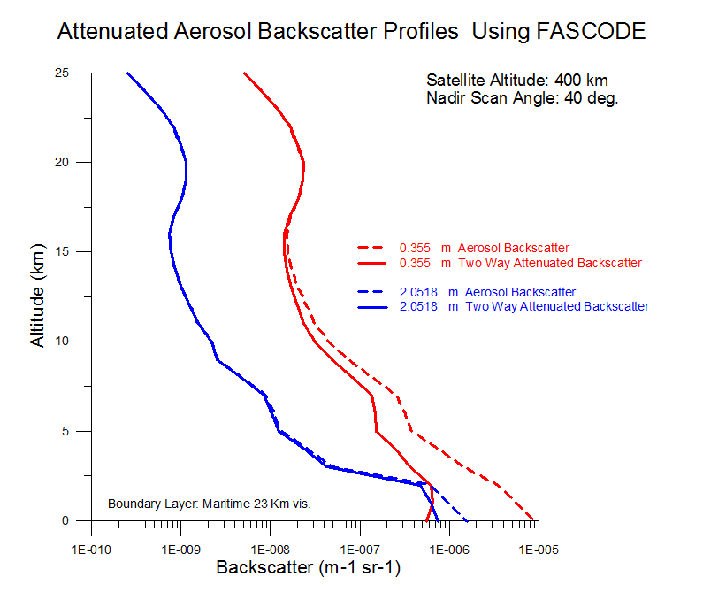

Slide 40
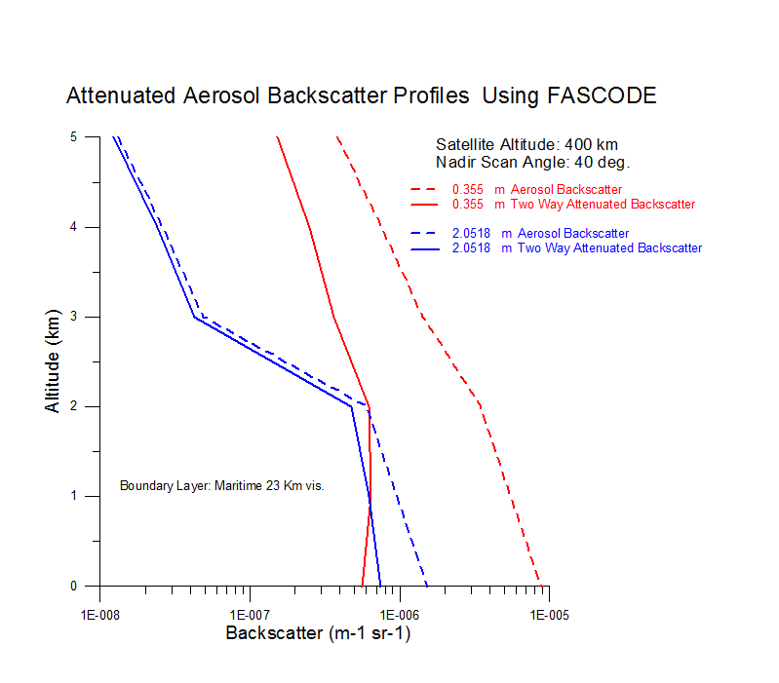

Slide 41
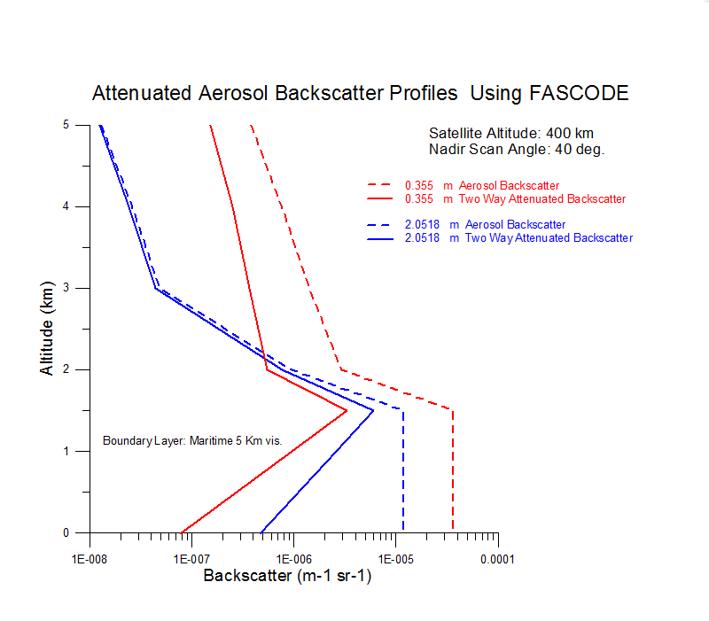

Slide 42
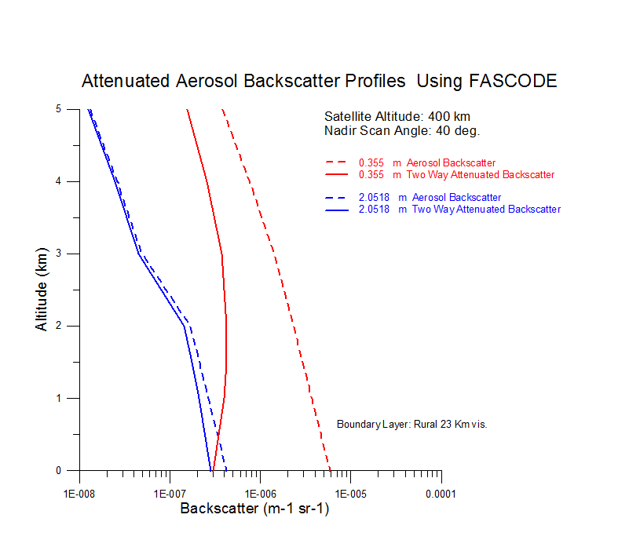

Slide 43
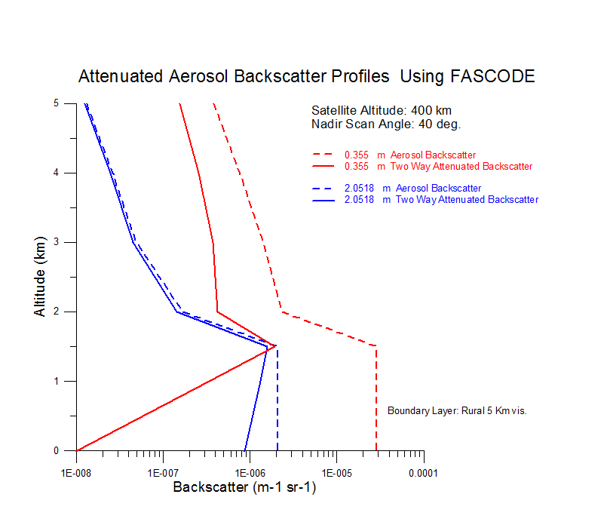

Slide 44
Areas for Enhancement
Employ a first order, source anchored set of air-mass types with differing backscatter (this was done in some of the first DWL simulations for OSSEs in the early 1990’s)
Add depolarization effects by clouds (especially thin cirrus)
Add solar background in a more advanced fashion (ground and clouds). Not just day/night adjustments to SNR.

Slide 45
Discussion
Given the constraints associated with OSSEs, how should we upgrade the Target Atmospheres, if at all?
What process should we use to vet changes?

Slide 46
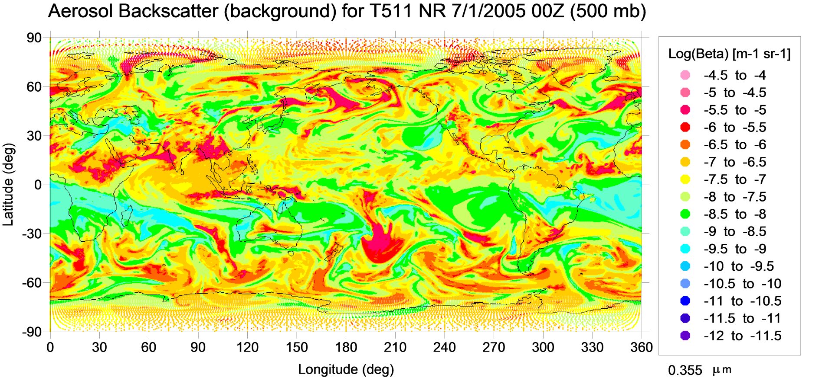
.355um Aerosol backscatter (RH organized)

Slide 47
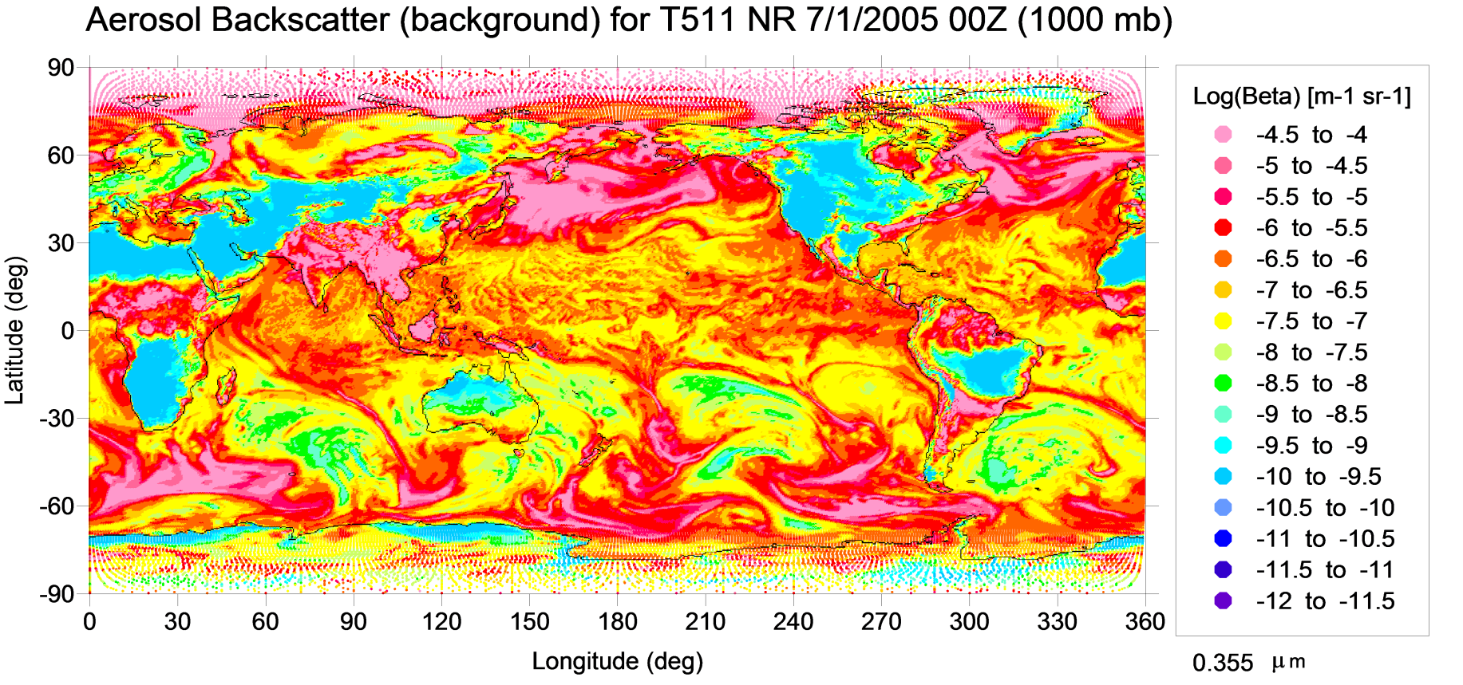
.355um Aerosol backscatter (RH organized)

Slide 48
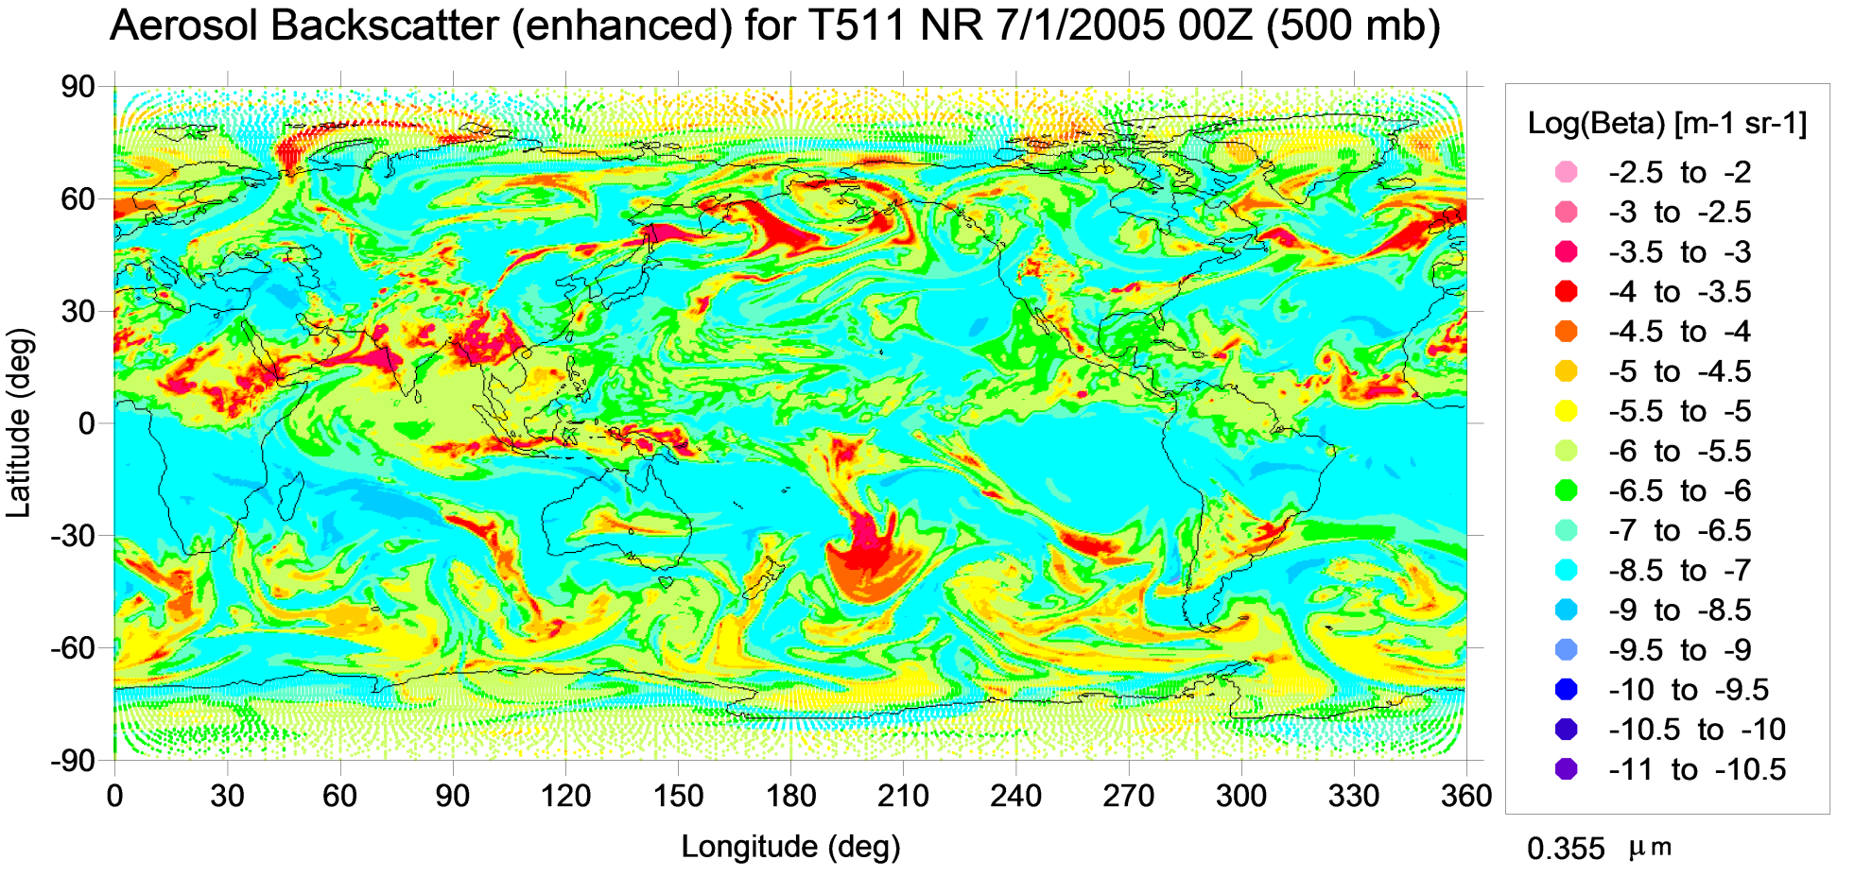
.355um Aerosol backscatter (RH organized)

Slide 49
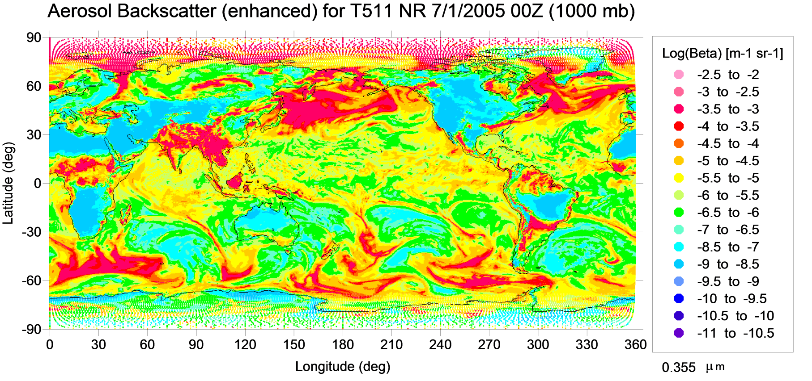
.355um Aerosol backscatter (RH organized)

